Slide 1

MERIDIAN DEVELOPMENT CORPORATION
2011 Annual Report

Slide 2
EXECUTIVE SUMMARY
Partnership, transportation and investing in our community were the hallmarks of 2011 in the urban renewal district.
Creating an atmosphere where businesses and entrepreneurs want to invest has never been more challenging or rewarding. This year was marked by a new building occupying a once partially vacant city block and the promise of approximately 25 new jobs to work and do business in downtown Meridian, the heart of our community. There are no magic fixes, but through the support of our business community and Meridian residents, we saw increased activity and investment in downtown. The Meridian Urban Market brought families into Generations Plaza and onto Idaho Street to enjoy food music and unique crafts. The Ground Floor moved from the Idaho location to one of the district’s buildings on Main Street to free up prime office/retail space and put activity onto a vacant corner at Broadway and Main. Over the course of the year, businesses that were part of the Ground Floor outgrew the offerings of the incubator and moved up an onward. We wish success for T-Sheets and Vertex Security.
Parking and transportation continues to be a challenge. Public meetings were conducted and a traffic plan were outlined by the Ada County Highway District this past year for Split Corridor Phase II and we are looking forward to the completion of the project in 2013.This facility will make stopping in our downtown a pleasure with a friendly pedestrian and bicyclist atmosphere. Those wishing to travel through will find it more convenient. We continue to work with downtown businesses and the City of Meridian to find the right mix of parking opportunities and enforcement to encourage people to frequent the businesses downtown and make it a safe and friendly work-environment for those who earn their living in the district.
The challenges of revitalization have not been easily met in these economic times. However, the dedication of the downtown residents and businesses, as well as the highly cooperative staff at the City, have made the task surmountable.
Best Wishes,
Julie Pipal, Chairman of the MDC Board

Slide 3
TABLE OF CONTENTS
PAGE 2 --- Executive Summary
PAGE 4 --- Board of Commissioners
PAGE 5 --- Meeting Times and Location
PAGES 6 & 7 --- Downtown Development, New Businesses in 2011
PAGE 8 --- MDC/COMPASS/VRT Partnership
PAGE 9 --- Downtown Investment, Split Corridor Phase II
PAGE 10 --- Downtown Investment, Parking
PAGE 11 --- Downtown Investment, The Ground Floor
PAGE 12 --- Downtown Investment, Streetscape Improvement Grants
PAGE 13 --- Downtown Investment, Meridian Urban Market
PAGE 14 --- Initiatives, Downtown Activities
PAGE 15 --- Coming in 2012
PAGE 16 ---- In Conclusion

Slide 4
BOARD OF COMMISSIONERS
A nine member Board of Commissioners makes up the Meridian Development Corporation. The Commissioners are appointed by the Meridian Mayor and City Council for rotating three-year terms.
LEADERSHIP:
Julie Pipal – Chairman
Craig Slocum – Vice Chairman
Eric Jensen – Secretary/Treasurer
BOARD MEMBERS:
Tammy DeWeerd
Keith Bird
Jim Escobar
Dave Winder
Lisa Keyes
Dan Basalone

Slide 5
Meeting Times and Location
The Meridian Development Corporation meetings are scheduled for the second Wednesday of the month at 7:30am and the fourth Wednesday of the month at 4:00pm unless otherwise publicly noticed.
Meetings are held in the Meridian City Hall North Conference Room on the main floor at 33 East Broadway Avenue in Meridian.
All meetings are open to the public and agendas are posted on www.meridiandevelopmentcorp.com.

Slide 6
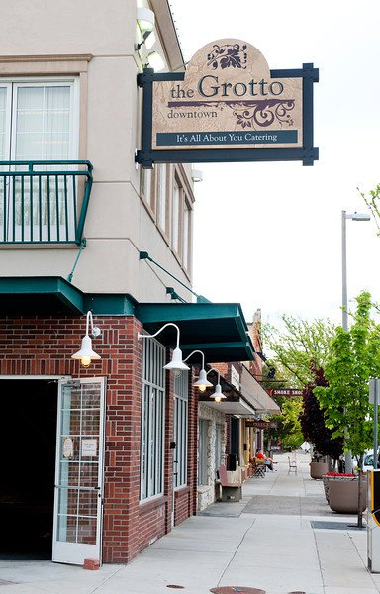
DOWNTOWN DEVELOPMENT
New Business in 2011
The Grotto, downtown Meridian’s newest eatery and coffee shop, opened for business at 112 East Idaho Street on February 15, 2011.
The owners of The Grotto have been in business since October 2002 in the Treasure Valley. They currently employ 15 people.
In addition to being a destination dining location, The Grotto is also a catering company that specializes in weddings, corporate events and funerals both on and off-site.

Slide 7
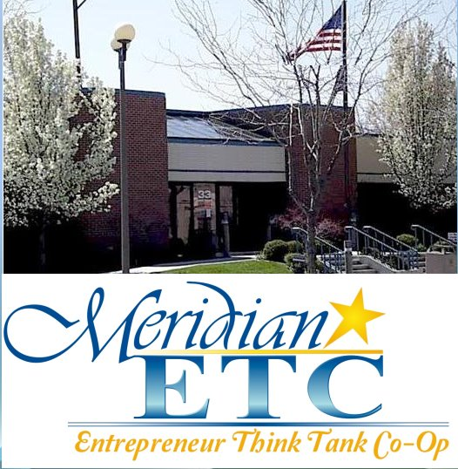
DOWNTOWN INVESTMENT
NEW BUSINESS IN 2011
In the late summer of 2011, the Meridian ETC leased space in the old Meridian City Hall located at 33 East Idaho Street.
Meridian ETC is a consortium of like-minded business owners and entrepreneurs committed to creating an atmosphere of collaboration, education, and support for each other as they operate and grow our businesses.
The ‘Co-op’ concept is unique in a number of ways from more traditional business models, in that each are member owners and operators
Their philosophy is that people are at the heart of their business and they follow the principles established by the International Co-operative Alliance and have also adopted the 5 Laws of Stratospheric Success (from the book ‘The Go-Giver’ written by Bob Burg and John David Mann) as our core value statements.

Slide 8
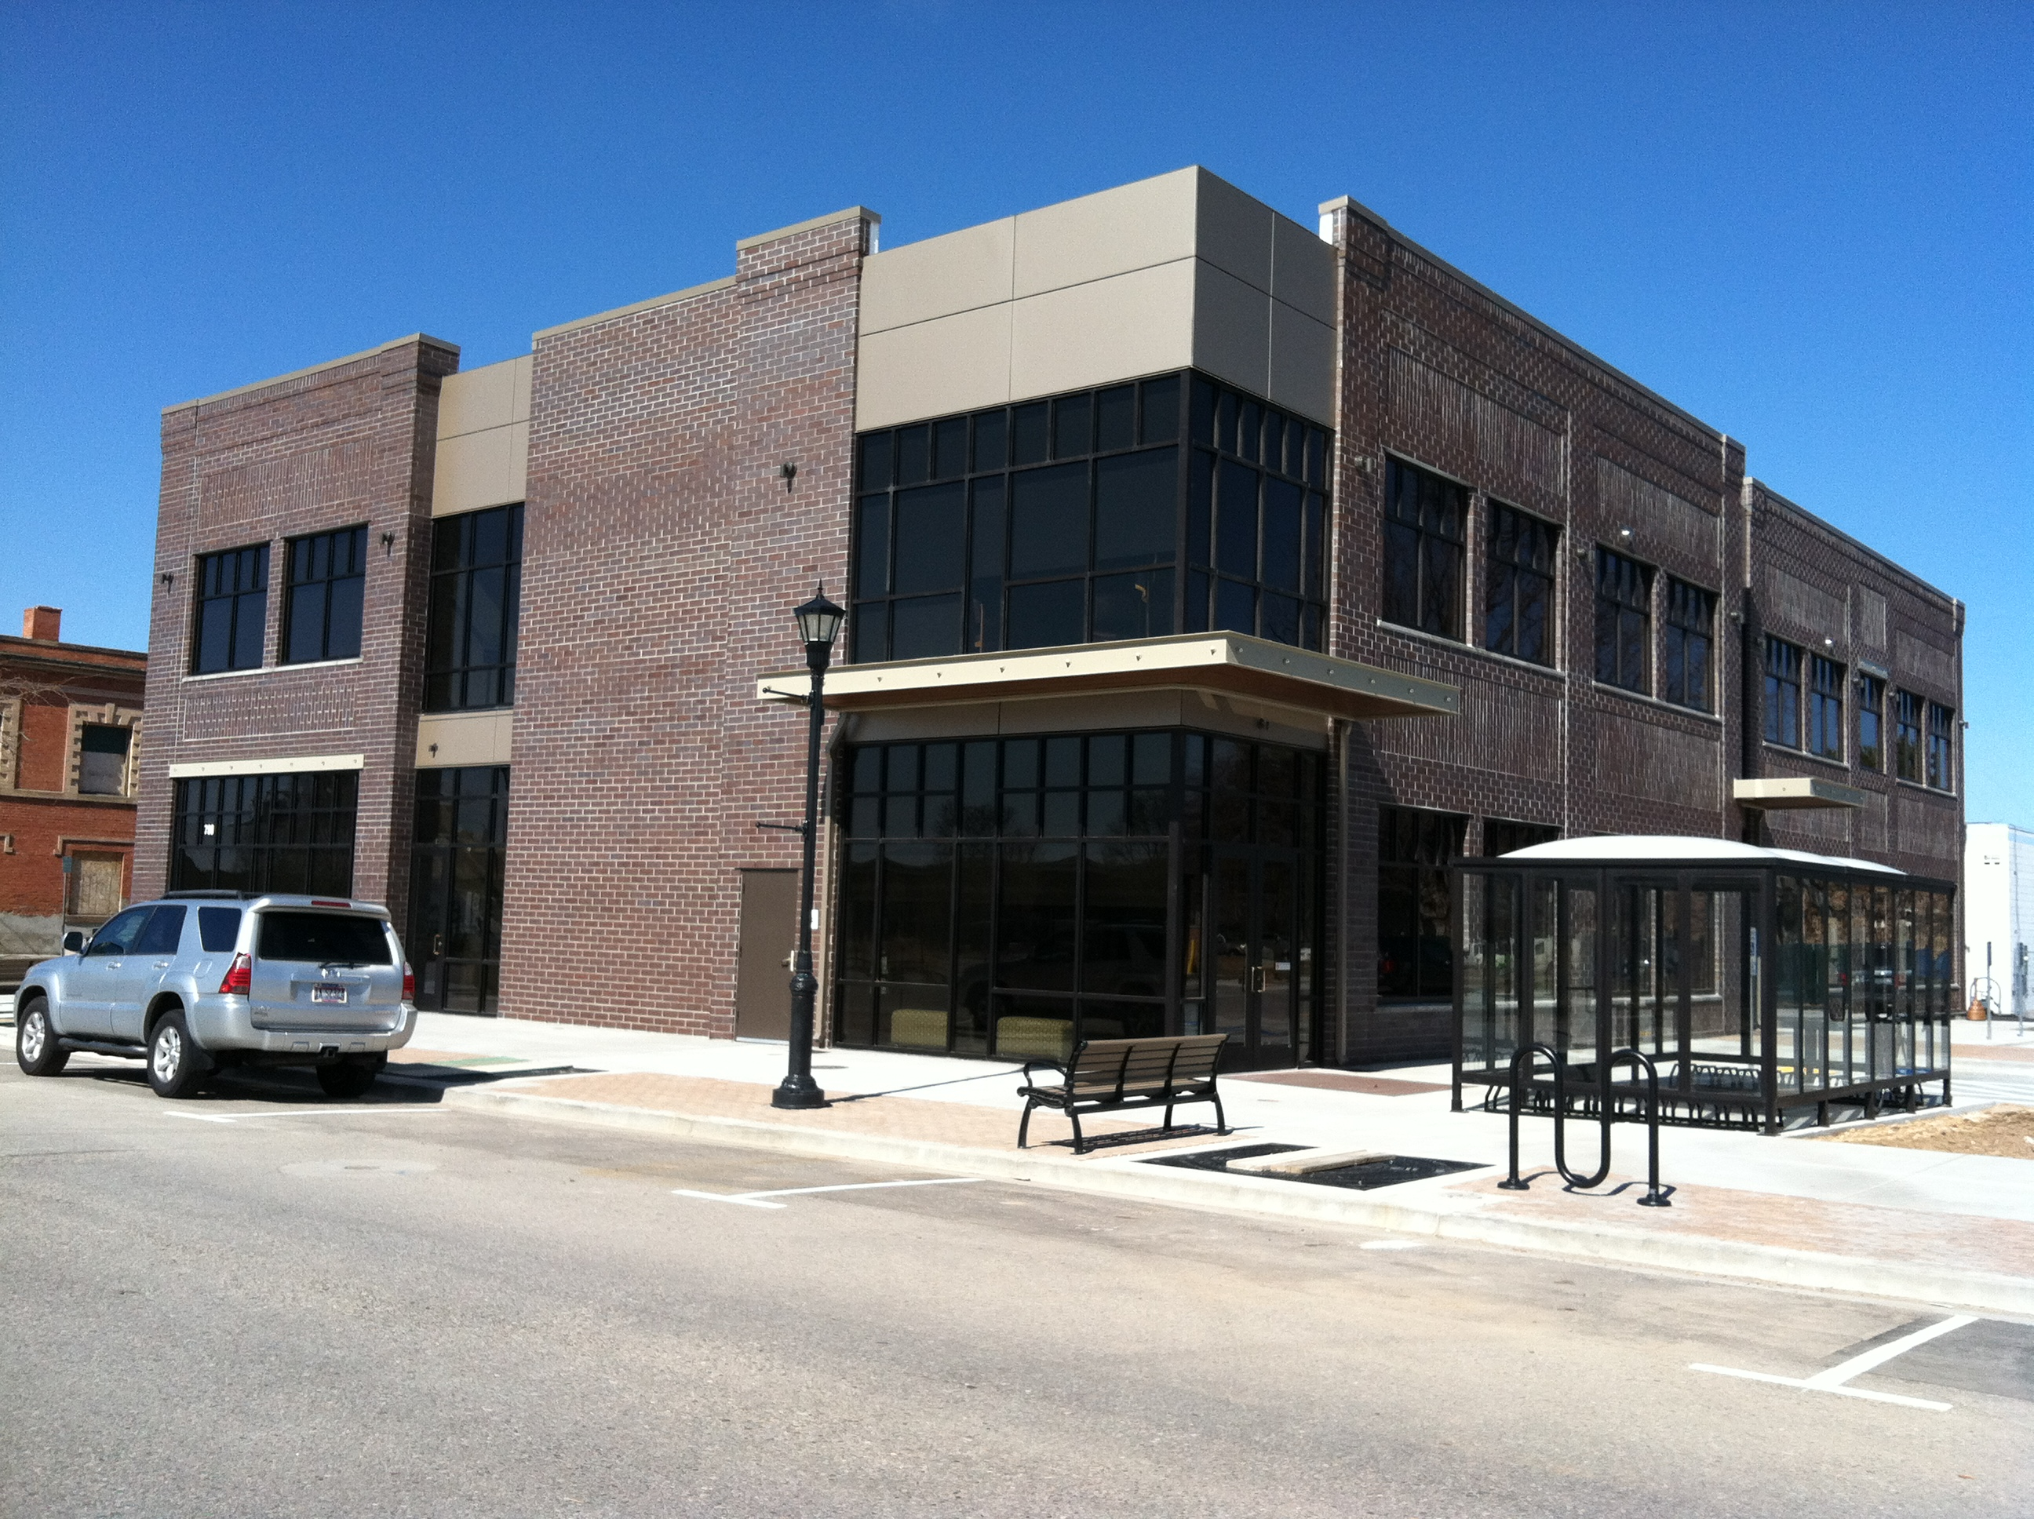
MDC/COMPASS/VRT PARTNERSHIP
In 2011, Meridian Development Corporation continued collaboration with two public partners, Community Planning Association of Southwest Idaho (COMPASS) and Valley Regional Transit (VRT) to build a new, 16,000 square foot, two-story office building that will house both transportation entities at 700 North East Second Street.
After a competitive bid process, the building began construction in April 2011 with temporary occupancy being given to the building in November 2011. VRT moved into the building in December 2011 and VRT is expected to move in January 2012.
The building is now the headquarters for COMPASS and VRT employees, volunteers and the members of both Boards. The hope is that the additional employment base in downtown Meridian will bring an added energy and impact to downtown Meridian. It was because of this partnership and impact that MDC chose to be involved in such a project. This project is a significant step toward bringing more energy, employment, redevelopment and additional private investment in this area.
The new building brings a parking lot that is for parking for COMPASS and VRT employees but has additional spaces for free public parking during weekday, evening and weekend hours. The parking lot will be owned by MDC.
It is MDC’s hope that the newest mobility-minded additions to our community will help drive additional interest in future projects in the downtown core. This site has great potential to eventually become a mass transit hub and draw even more excitement, investment and benefit to everyone involved with our downtown – especially our businesses.

Slide 9
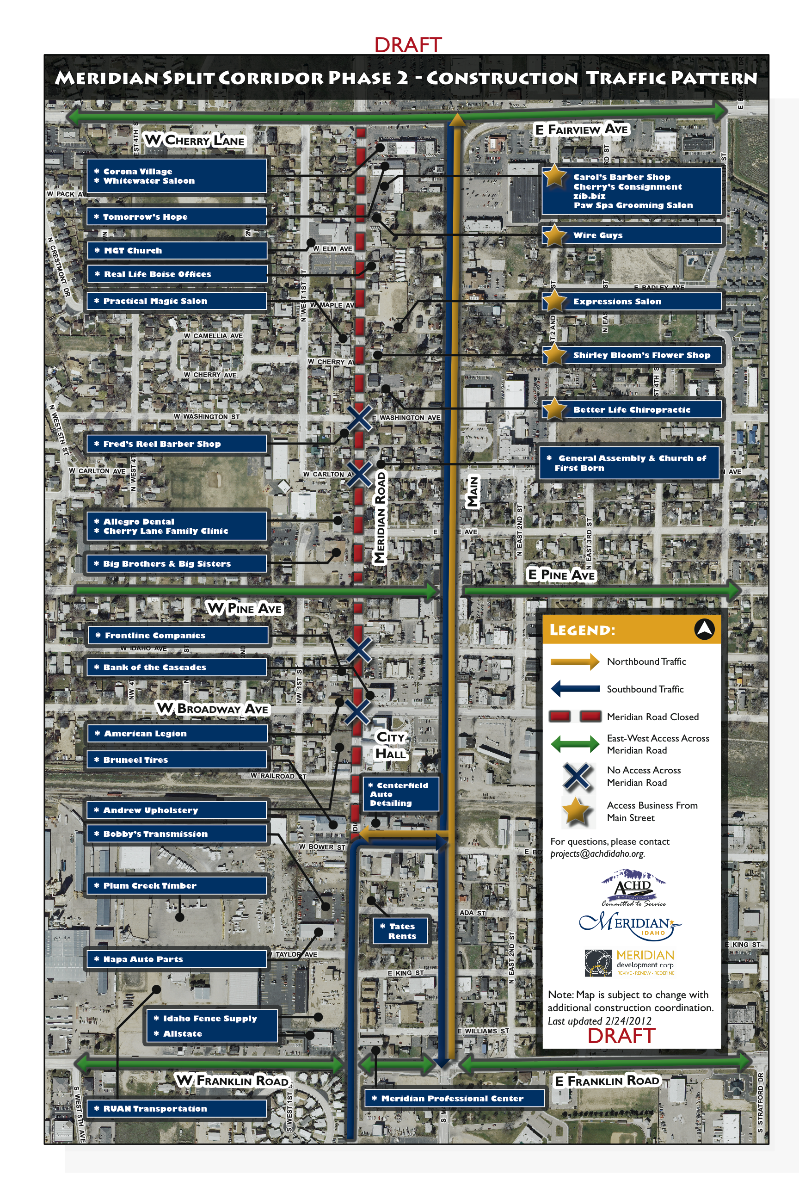
DOWNTOWN INVESTMENT
SPLIT CORRIDOR PHASE II
Throughout 2011, MDC has continued to work in conjunction with the City of Meridian and the Ada County Highway District [ACHD] on the planning of Phase II of the Split Corridor project.
Construction of Phase II is expected to begin in the fall of 2012. Phase II will include widening of Meridian Road to five lanes and the construction of a “cross-over” road in the area of King Street and Bower, linking traffic from Main Street to Meridian Road. MDC is working with the City and ACHD to evaluate opportunities to minimize impacts to businesses during the 12-month construction and to evaluate opportunities such as signage, way-finding and floodplain modification.
As part of the overall project, MDC has been working with a traffic design consultant on a lighting plan for the corridor. The lighting plan will be implemented as a part of the overall project.
The project’s expected completion date is late 2013 or early 2014.

Slide 10
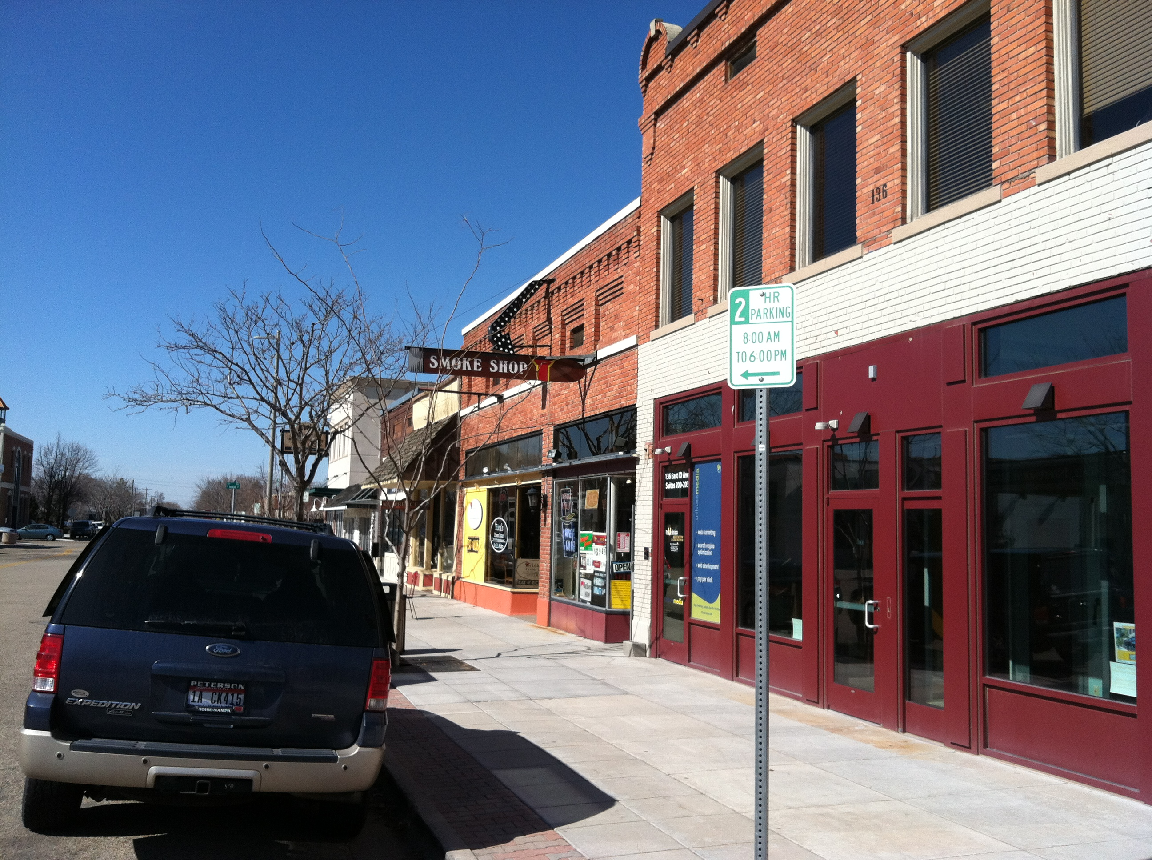
DOWNTOWN INVESTMENT
PARKING
Currently, Meridian Police enforce time limitations between 8 a.m. and 6 p.m., Monday through Friday, on designated street in the area from Carlton Avenue to the railroad tracks and Meridian Road to Third Street. The enforcement is geared to ensure more parking is available for downtown patrons.
Based upon concerns from business owners, patrons and interviews, MDC convened a committee to evaluate the parking in Meridian’s downtown core specifically focusing on Broadway Avenue to the south, Second Street to the east, Pine Street to the north and Meridian Road to the west.
The evaluation included interviews with those impacted by the parking regulations and discussions with ACHD and the City of Meridian’s Police Department.
Recommendations will be made to the MDC Board in early 2012 with a public outreach program prior to final adoption.

Slide 11
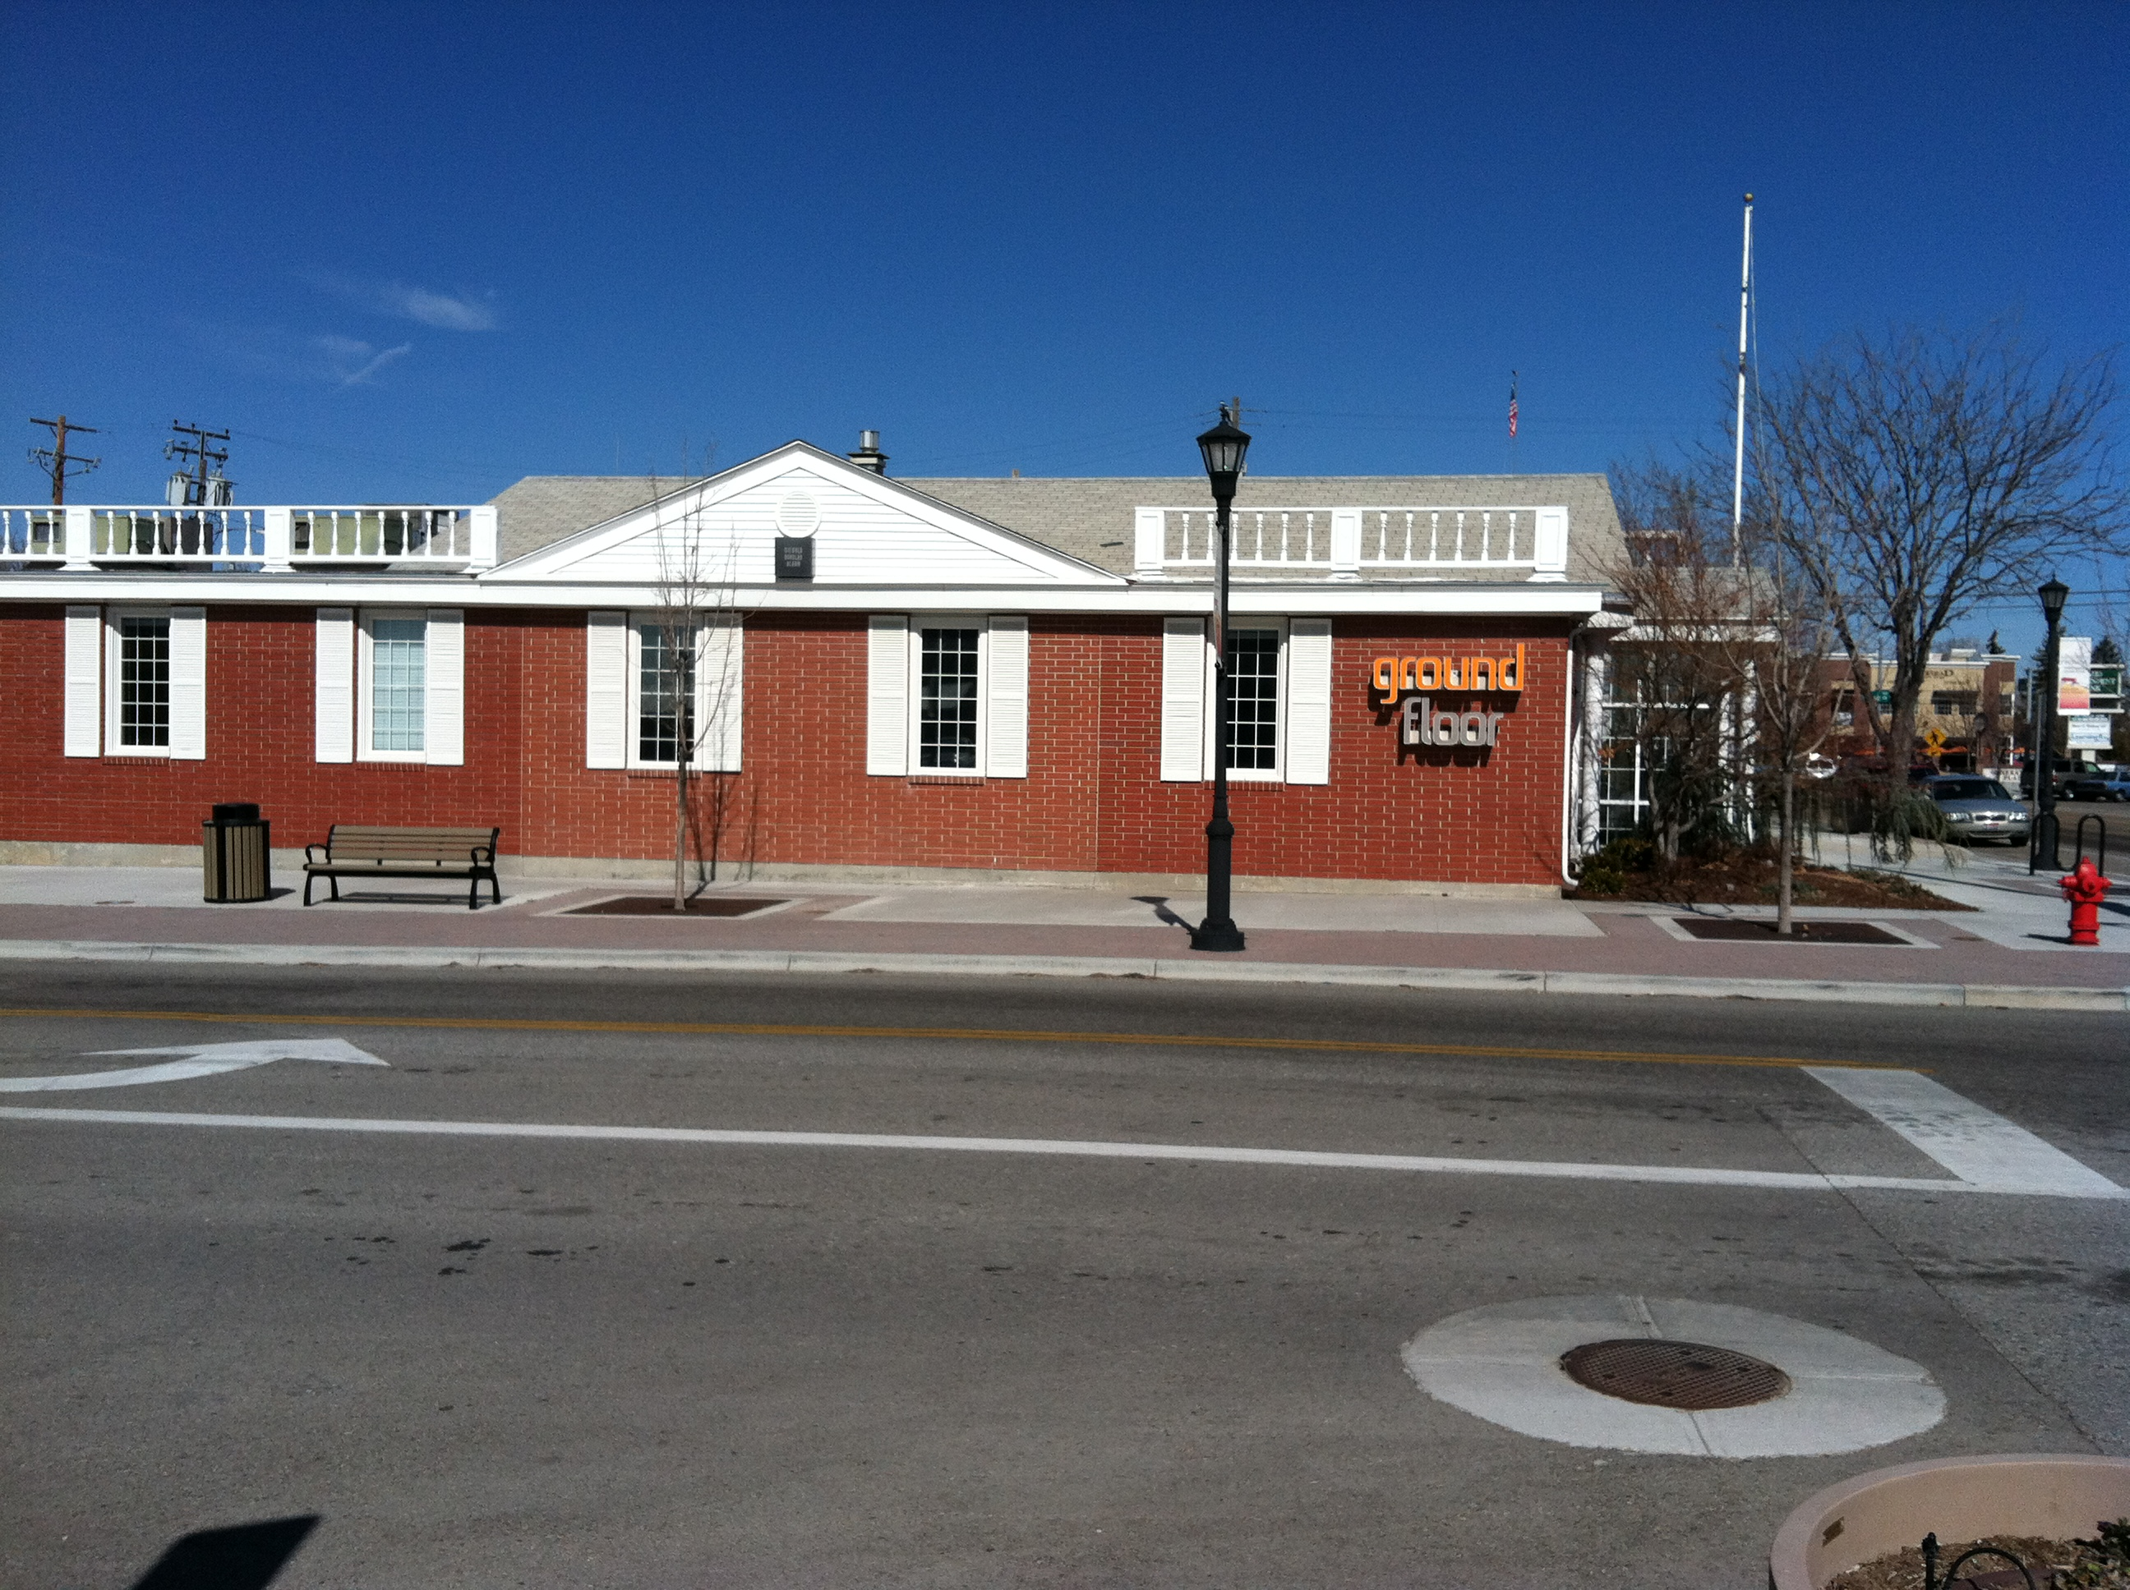
DOWNTOWN INVESTMENT
THE GROUND FLOOR
MDC is committed to fostering a culture of innovation in Downtown Meridian.
The Ground Floor was founded by the MDC to facilitate and encourage emerging businesses in the downtown core. The Ground Floor offers entrepreneurs shared space memberships to pursue their business ventures and as of December 2011, there are now available offices for lease. The Ground Floor workspace is flexible and can be easily configured for business trainings, collaboration group meetings, gathering space for local organizations and community events.
Since opening in 2010, the Ground Floor has provided economical workspace for a wide variety of businesses including web site development and marketing firms, an iPhone application designer, an alternative fuel enhancement developer, an innovator in security, home hospice consultant, a not-for-profit business consultant.
In December 2011, the Ground Floor relocated from a space MDC leased at 136 Idaho Street to an MDC owned building at 703 North Main Street. The new location provides more leasing options by way of offering private offices in addition to the shared space option.

Slide 12
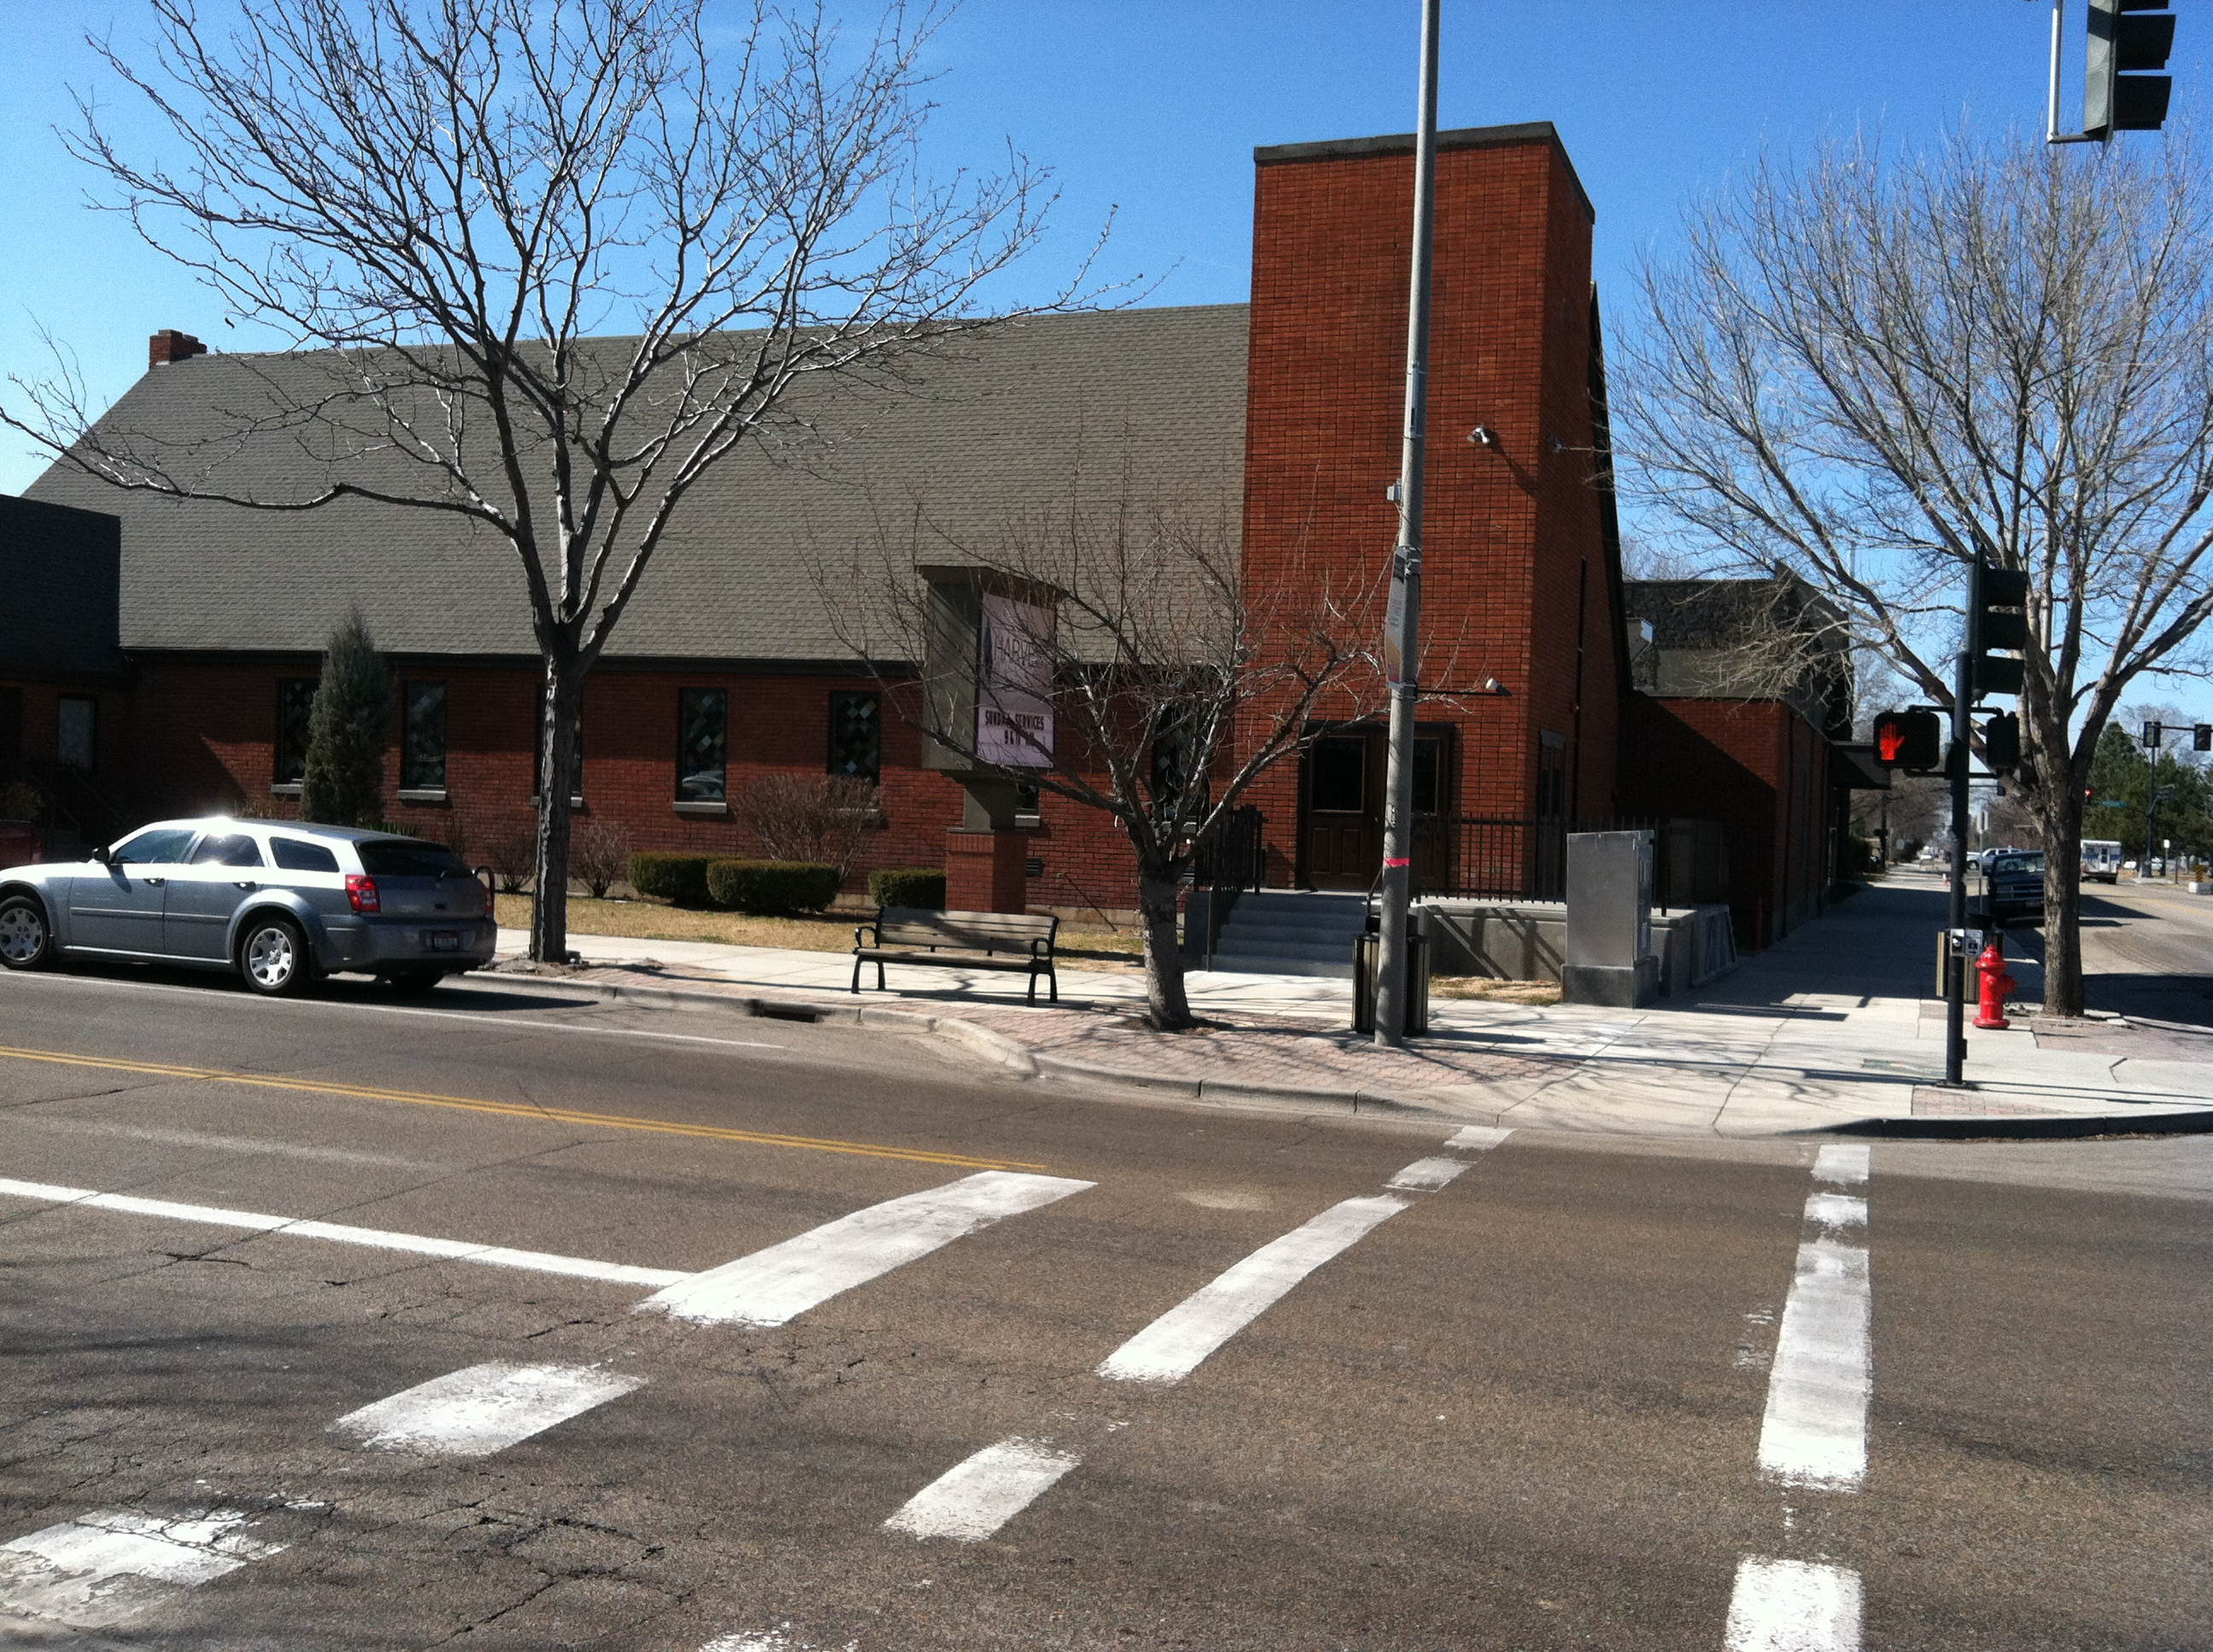
DOWNTOWN INVESTMENT
STREETSCAPE IMPROVEMENT GRANTS
In 2010, Meridian Development Corporation awarded a $35,000 Improvement Grant to the Church of the Harvest located at Pine Avenue and Main Street.
The Church is currently undergoing an extensive building expansion and remodel and as part of the overall revitalization came to MDC for funding assistance for the desired streetscape improvements.
The improvements include installing trees and lights on the sidewalk, installation of irrigation and demolition and replacement of the sidewalk. The project will be completed in the Fall of 2012.

Slide 13
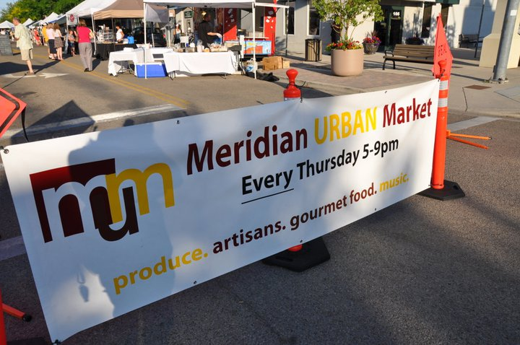
DOWNTOWN INVESTMENT
MERIDIAN URBAN MARKET
In 2011, Adrian + Sabine created the concept called the Meridian Urban Market to Meridian’s downtown core during the months of May through September.
The concept was to bring neighborhood farmer’s market, artisan market, and Meridian-area food “tasting” experience, paired with local art, live local music, and a beer and wine garden stocked with local product. Family-friendly activities were provided at no cost to patrons, including arts activities for children.
The market took place on Thursday evenings from 5-9pm and was geared to drive traffic to area businesses which are open summer evenings, and to create awareness for all of downtown Meridian core, providing a long-term opportunity to foster urban development and provide a missing cultural experience for Meridian locals.
Adrian + Sabine is working in partnership with the Meridian Chamber of Commerce for Summer 2012 plans.

Slide 14
INITIATIVES
DOWNTOWN ACTIVITIES
The City of Meridian’s downtown continues to come into its own with special events and entertainment which has been successful in bringing residents to downtown.
Meridian City Hall’s outdoor plaza continues to be a key gathering place for key events such as the Third Annual Concerts of Broadway series featuring jazz, swing and symphony genres, the Public Works Expo, two Meridian Business Days and the Christmas Tree lighting to name a few.
Elsewhere in the Urban Renewal District, the historic Dairy Barn came home to the Meridian’s bravest for the firefighters’ popular annual Chili and Salmon Feeds.

Slide 15
COMING IN 2012
On the horizon for MDC includes:
COMPASS/VRT Building: Ultimate completion of construction and ultimate occupancy of the COMPASS/VRT Building located at 700 N East Second Street
Nine Mile Floodplain Study: Completion of the first of a three phase floodplain study with the goals of assisting of business and/or property owners who currently reside in the Nine Mile Floodplain.
The Ground Floor: Work towards the continued evolution and expansion of services of the Ground Floor and continue to work with the Citizen’s Task Force to create partnerships.
Urban Land Institute Task Force: Participate in a study of Meridian’s downtown core with a ULI panel to identify opportunities to capitalize upon in the next 6-12 months.
Wayfinding and Signage: Work with an advisory group to identify and begin implementation of a wayfinding and signage effort for downtown Meridian.
Public Involvement: The foresight to continue to look towards collaborating with new and existing business owners to create continued opportunity in downtown Meridian.

Slide 16
IN CONCLUSION
Meridian Development Corporation is committed to public service, fiscally responsible use of urban renewal dollars and public transparency. The following are links to MDC efforts of public and stakeholder interest:
MDC Website: www.meridiandevelopmentcorp.com
Ground Floor Website: www.meridiandevelopmentcorp.com/groundfloor
Destination Downtown Website: www.destination-downtown.org
MDC Contact Information:
Ashley Ford, MDC Project Manager
ashley@meridiandevelopmentcorp.com
208.477.1632
Mailing Address: 33 East Broadway Avenue, Meridian, Idaho 83642
Physical Address: 703 North Main Street, Meridian, Idaho 83642

