Slide 1

MERIDIAN DEVELOPMENT CORPORATION
2013 Annual Report

Slide 2
TABLE OF CONTENTS
PAGE 3 --- Executive Summary
PAGE 4 --- Board of Commissioners
PAGE 5 --- Board of Commissioner Meetings
PAGE 6 --- Downtown Investment, Meridian Road Split Corridor, Phase II
PAGE 7 --- Downtown Investment, Downtown Parking
PAGE 8 --- Downtown Investment, Façade Improvement Program
PAGE 9 --- Downtown Investment, Streetscape Improvement Program
PAGE 10 --- Downtown Investment, Wayfinding and Signage Program
PAGE 11 --- Downtown Partnership, Treasure Valley Children’s Theatre
PAGE 12 --- Initiatives, Downtown Wine Cooperative Exploration
PAGE 13 --- Initiatives, Downtown Activities
PAGE 14 --- Coming in 2014
PAGE 15 ---- In Conclusion
APPENDIX A --- MDC Fiscal Year 2013 Annual Audit

Slide 3
EXECUTIVE SUMMARY
The City of Meridian is one of the greatest in the country, as it is regularly being noted in publications nationwide. Not only has it been the great businesses, agencies and residents which have nurtured this success, but it has been the result of a long-term vision being implemented in a variety of manners. The roles and responsibilities of an urban renewal agency are but one of those manners, one in which you find this report being dedicated. Years of strategic planning have been developing a vision towards what our city urban renewal agency district can become. This vision, is one that has been developed by the stakeholders and is implemented in a way that inspires positive outcomes.
Most notably in our recent history was the creation of a clear identification of how our city could continue to develop. Through the “Destination: Downtown” plan, we have been able to establish an identity to the many parts of our core along with a transparent set of goals towards continuing our positive growth. With the results of 2013’s success, you will now notice identity signage to and throughout the downtown core. This will be expanded in 2014 and beyond for the entirety of the district. This will allow the people of Meridian to associate with the various historical and future growth areas in town, providing an identity to the district in which the people of Meridian choose to work, live or play. In addition, with our Meridian Road Split Corridor Phase II project now complete, the people of Meridian can now see the light and appreciate the new entryways to and through our city core.
During this past year, there has been a focus in establishing clearer means of traffic patterns and availability to parking resources – through a combined effort within several of our subcommittees. Not only have we completed the design (construction occurring in 2014) of an expansion of over two dozen parking stalls within a 1-2 minute walk of most all areas in the downtown core, but we have also opened back up a renewed partnership with another downtown entity allowing free public parking during the daytime hours of another two dozen or more spaces. You may even notice all the striping of the existing parking along the curbs is renewed, yet another task clearly showing how we can most maximize our parking capabilities in the core.
Along with these mentioned items, there is a lot more happening which you will find in the following presentation: façade improvements, business partnerships, streetscape plans, etc. Without focus and direct attention on attaining the goals of importance, we will simply be bobbers floating in an ocean of potential. Well for me, and for many I speak with on a daily basis, we will not leave the success of our city to the currents… instead, we want to be a speed boat, racing towards the goals that we set as valued and important. Thank you for your interest, we value your time, and we invite you to jump on board with us for many more years of continued success!
Best Wishes,
Jim Escobar, Chairman

Slide 4
BOARD OF COMMISSIONERS
A nine member Board of Commissioners makes up the Meridian Development Corporation. The Commissioners are appointed by the Meridian Mayor and City Council for rotating three-year terms.
2013 LEADERSHIP:
Julie Pipal – Chairman
Jim Escobar – Vice Chairman
Dan Basalone – Secretary/Treasurer
2013 BOARD MEMBERS:
Mayor Tammy de Weerd
Meridian Council Member Keith Bird
Eric Jensen
Dave Winder
Kit Fitzgerald
Luke Cavener

Slide 5
BOARD OF COMMISSIONER MEETINGS
The Meridian Development Corporation meetings are scheduled for the second Wednesday of the month at 7:30am and the fourth Wednesday of the month at 4:00pm unless otherwise publicly noticed.
Meetings are held at the Meridian City Hall in the North Conference Room on the main floor at 33 East Broadway Avenue in Meridian.
MDC also has a variety of subcommittees focusing on specific projects or initiatives. Stakeholder participation is not only welcome but encouraged. All board and subcommittee meetings are open to the public and are posted on www.meridiandevelopmentcorp.com. For more information, please contact Ashley Ford, MDC Administrator at meridiandevelopmentcorp@gmail.com.

Slide 6
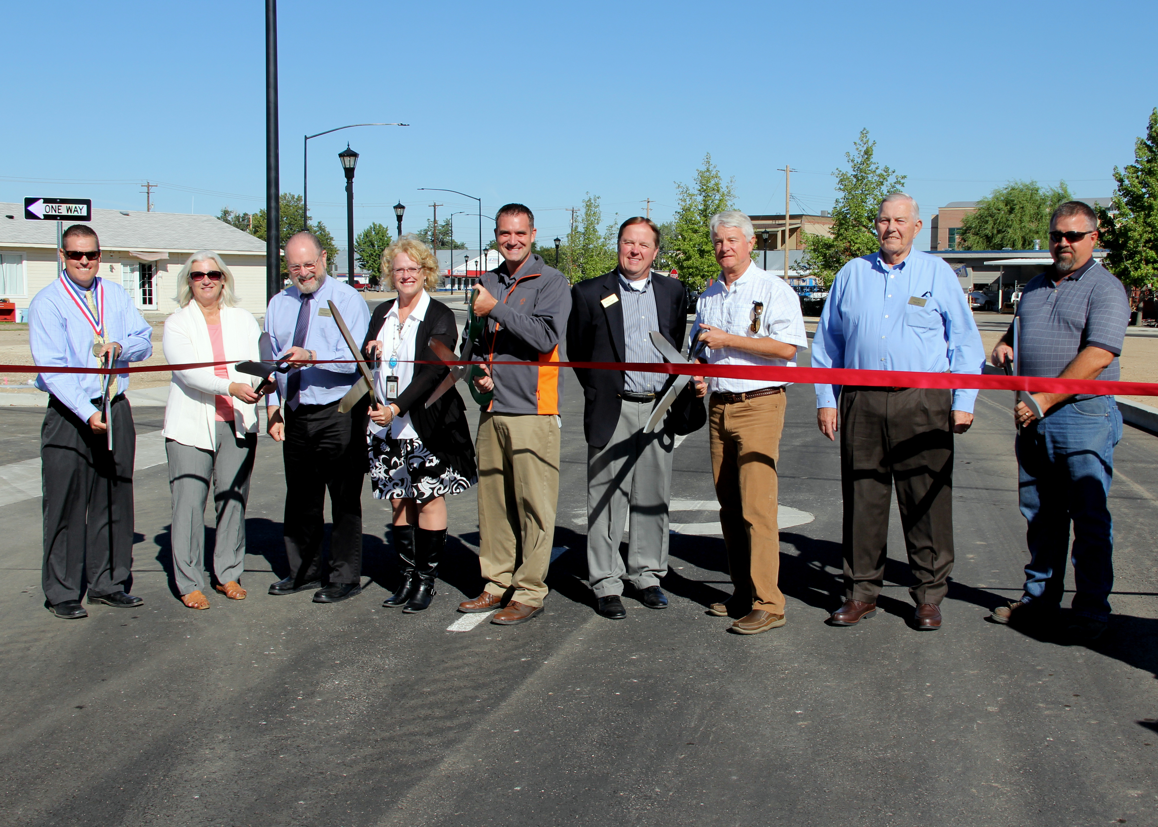
DOWNTOWN INVESTMENT
MERIDIAN ROAD SPLIT CORRIDOR, PHASE II
Throughout 2013, MDC continued to work in a three-way partnership with the City of Meridian and the Ada County Highway District on the construction of Phase II of the Meridian Road Split Corridor project.
Construction of Phase II began in the Fall of 2012 and continued through the Summer of 2013 with the grand opening occurring weeks ahead of schedule on September 19, 2013.
Phase II included the widening of Meridian Road to five lanes and the construction of a “cross-over” road in the area of King Street and Bower, linking traffic from Main Street to Meridian Road. It also included major infrastructure upgrades for water, sewer and irrigation.
MDC’s contribution to the project was the financing of the design and construction of the historic lighting along the Meridian Road corridor. The lighting was an important element of the project which enhances safety for pedestrians on a busy thoroughfare. It also creates the sense of place as one of the main corridors through downtown Meridian and lets visitors know they are in a special location in Meridian.

Slide 7
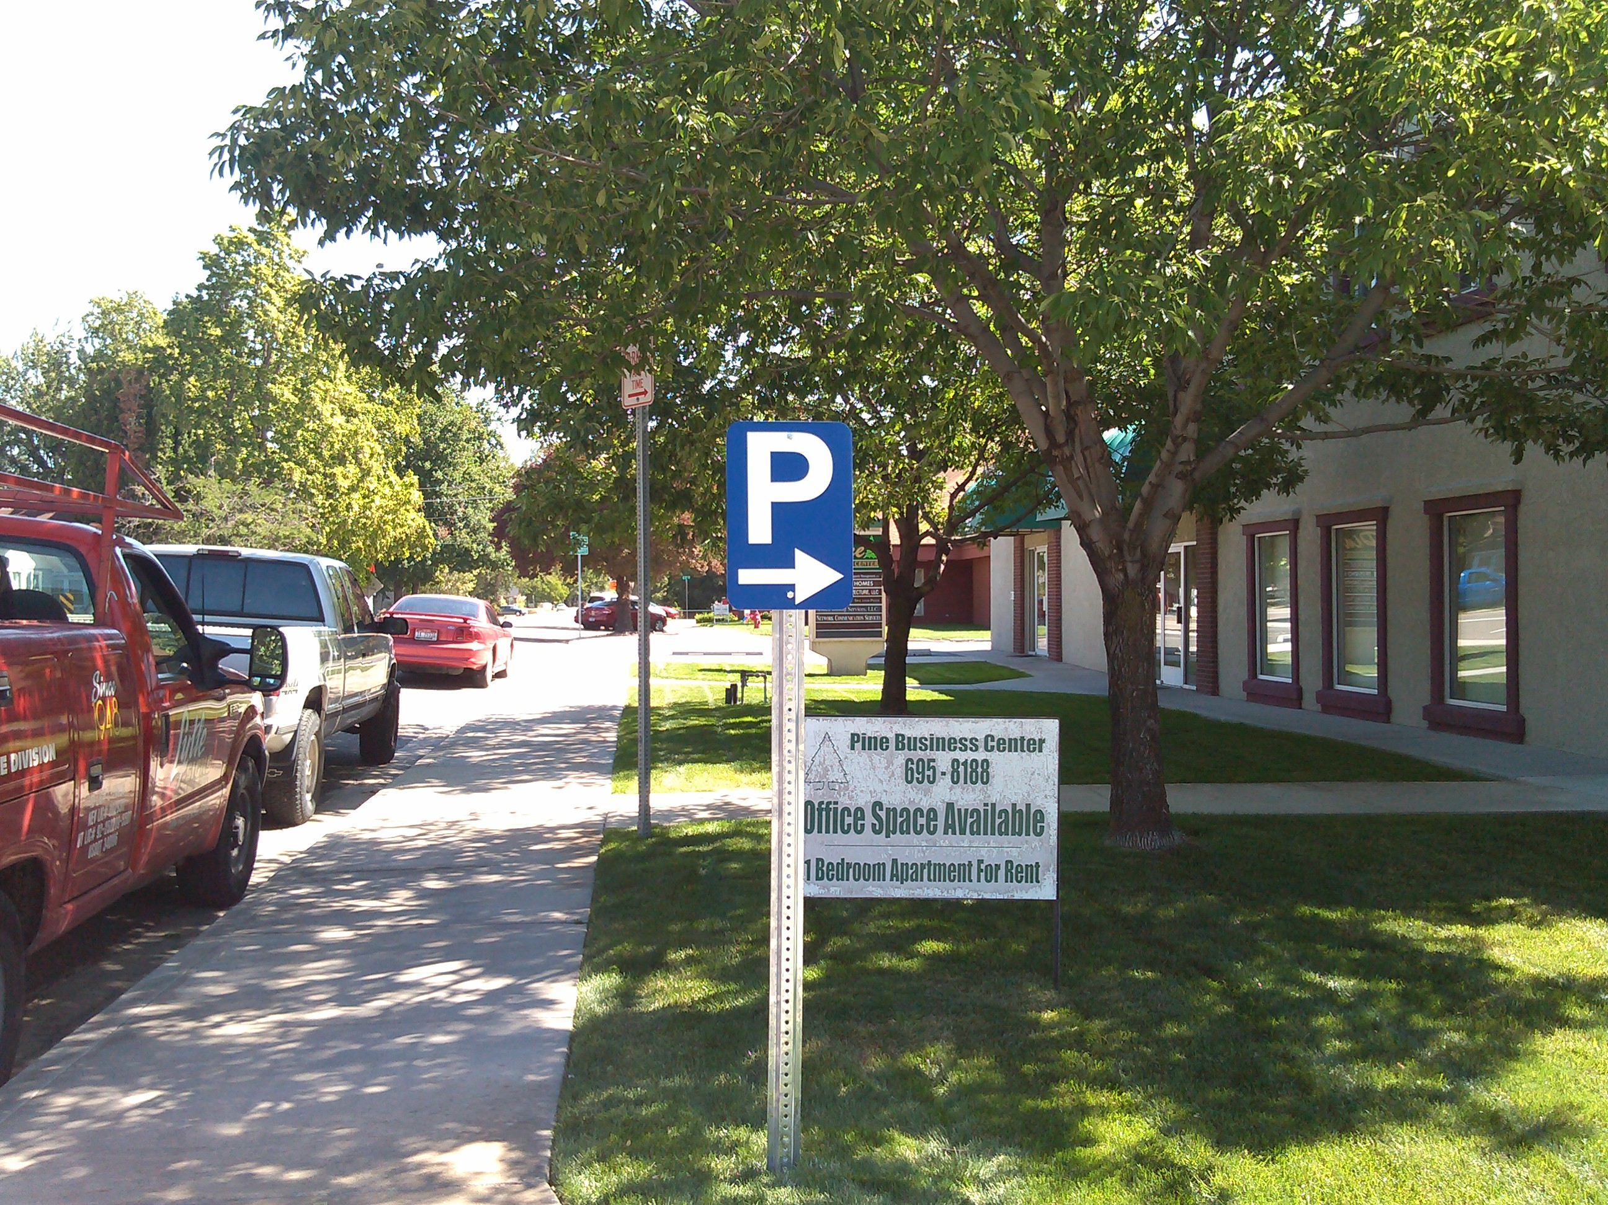
DOWNTOWN INVESTMENT, PARKING
As parking is key to redevelopment and private investment in Meridian’s downtown, MDC has been working on a number of initiatives throughout downtown Meridian. Some key initiatives in 2013 include the following:
* Working with the City of Meridian to remove any perceived barriers to redevelopment relating to parking. MDC repealed the “fee in-lieu of policy” and supported the City in evaluating ways to reduce the parking requirements in downtown.
* Partnering with ACHD to create additional public parking opportunities along South Broadway Avenue for downtown businesses and their employees along with patrons.
* Designing and implementing a public parking signage program to direct patrons to the free public parking provided in the downtown core.
*Restriping Meridian’s downtown core to create additional on-street public parking spaces.
*Finalizing a partnership agreement to begin in 2014 with the Masonic Temple Lodge to create additional public parking opportunities.

Slide 8
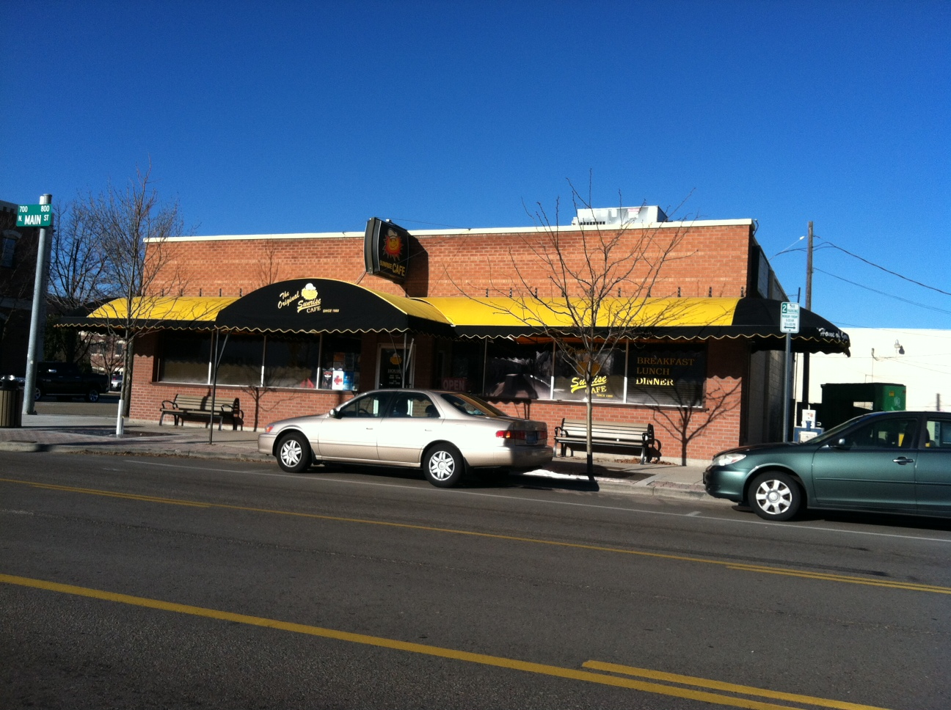
DOWNTOWN INVESTMENT,
FAÇADE IMPROVEMENT GRANT PROGRAM
MDC envisions a restored and revitalized downtown with local boutique and profitable businesses in an enjoyable setting for people to shop, to do business and to enjoy themselves.
To improve and maintain the historic character of buildings and to create a visual sense of place in downtown Meridian, property owners or business applicants may apply for grant funds to partially finance projects.
Through FY2013, MDC worked in partnership with the City of Meridian and their Community Development Block Grant program that assisted in the partial funding of the Façade Improvement Program. The other portion was provided through MDC’s general budget.
MDC has continued to conduct public outreach to ensure that property owners, and/or business owners are aware of and understand the grant program.
In 2013, MDC approved one fund recipient, the Sunrise Café. They installed new and bright awnings on the front façade. In addition, MDC continued to work with 2012 grant recipients on the completion of their projects.

Slide 9
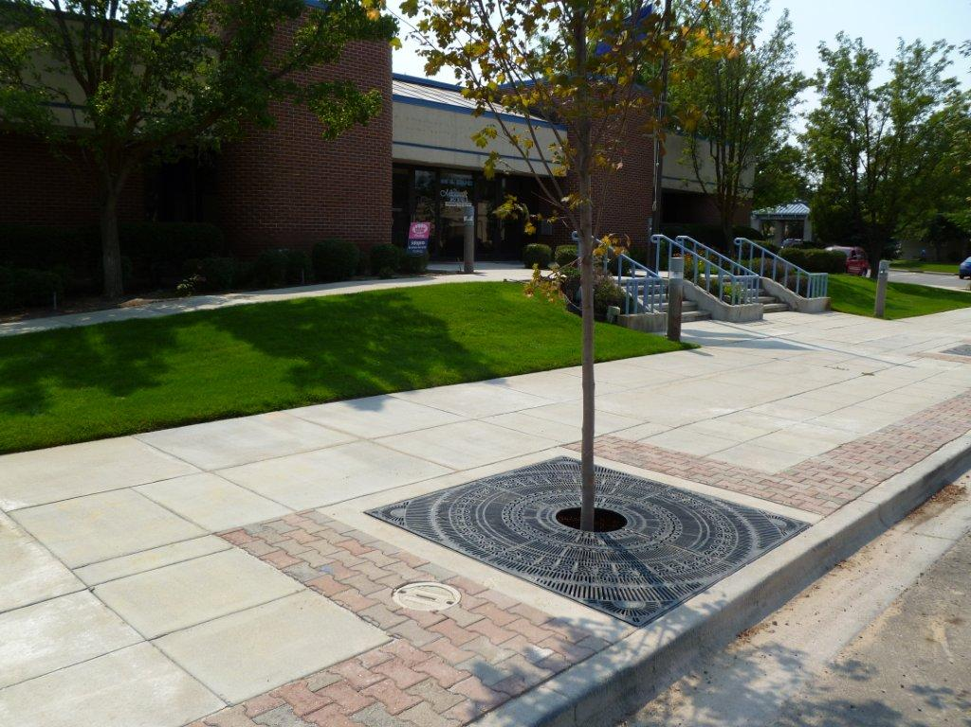
DOWNTOWN INVESTMENT,
STREETSCAPE IMPROVEMENT PROGRAM
Each year, MDC places a high priority on various streetscape improvements in Meridian’s downtown core. 2013 was no exception and saw the following accomplishments:
* The continuation of an annual $25,000 partnership contribution to the Meridian Parks and Recreation Department for the replacement of trees in Meridian’s downtown.
* The engagement of a professional engineer to assist MDC in the design of Main Street streetscape improvements that will be constructed in FY2014.
*The engagement of a professional engineer and completion of a historical lighting study for Main Street from the new split corridor cross-over to Cherry Lane. This study will allow MDC to begin budgeting for historical light installation in phases.

Slide 10
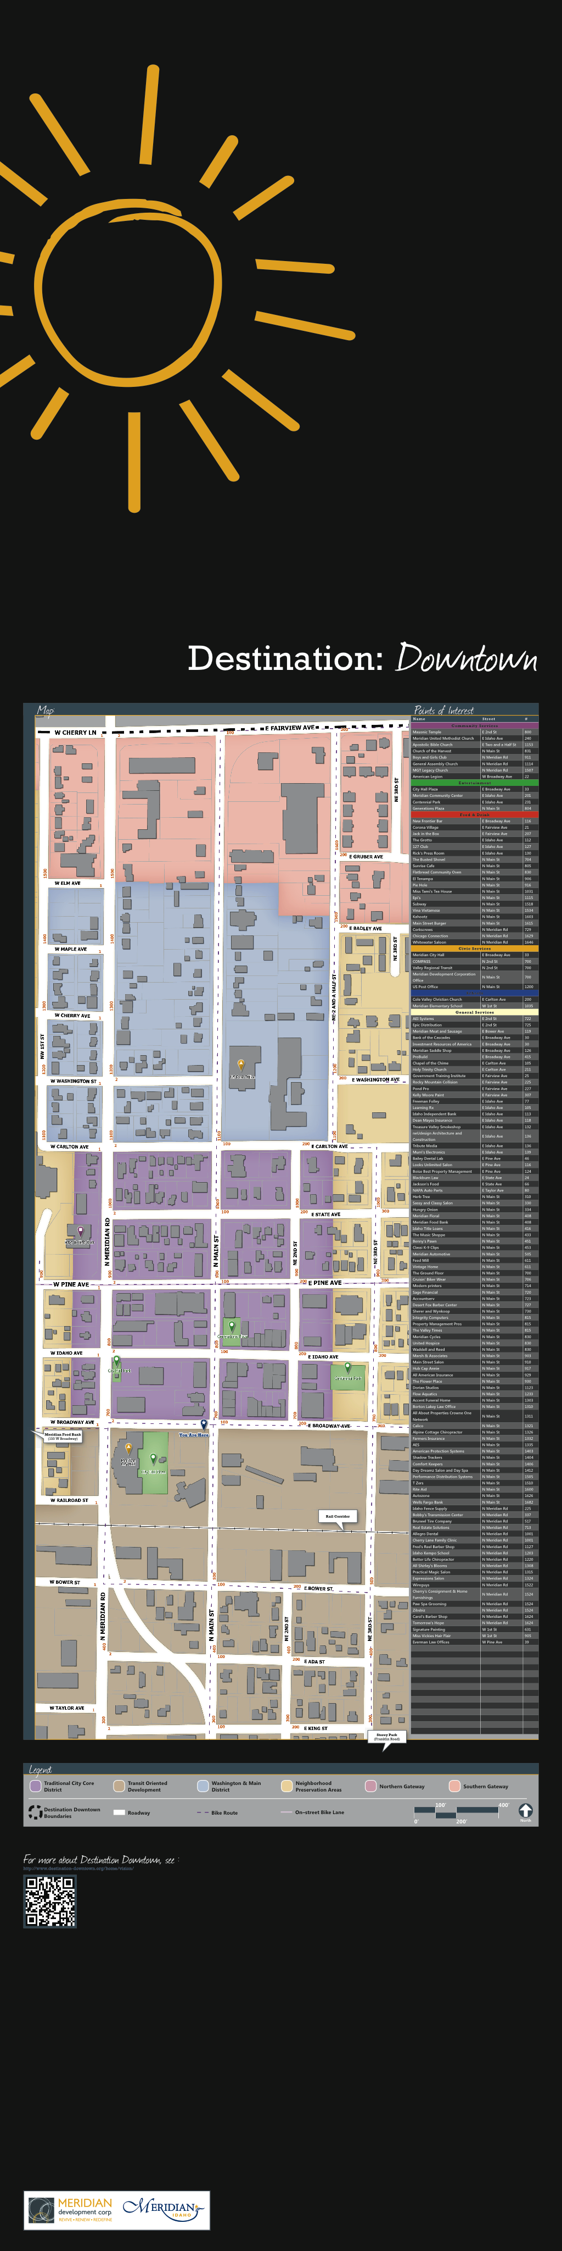
DOWNTOWN INVESTMENT,
WAYFINDING AND SIGNAGE PROGRAM
MDC has worked diligently over the course of the past two fiscal years to begin a formal wayfinding and signage program in downtown Meridian.
2013 saw the installation of the first business directory kiosk located on the southwest corner of Main Street and South Broadway Avenue in front of Meridian City Hall. Late in 2013, the MDC Board approved funding for two additional kiosks to be installed in Generations Plaza and on the northeast corner of Main Street and Carlton Avenue in front of the Post Office.
Further, the first of the Destination: Downtown banners were installed in the downtown core identifying the Old Town, the Washington & Main and Northern Gateway Districts along Main Street.
In late 2013, MDC engaged a consultant to begin the process for a master wayfinding and signage effort for the entire MDC district which will include entrance signage, directional signage, additional kiosks, installation of additional Destination: Downtown banners and other forms of signage.

Slide 11
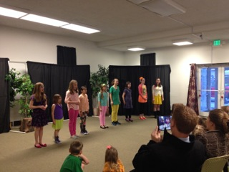
DOWNTOWN PARTNERSHIP,
TREASURE VALLEY CHILDREN'S THEATRE
In 2013, MDC advertised for lease or purchase proposals for each of its two buildings located at 703 and 713 North Main Street respectively. The Treasure Valley Children’s Theatre [TVCT] was one of the respondents for the old Farmers and Merchants building at 703 North Main.
In November 2013, MDC entered into a one-year lease with TVCT. The addition of TVCT into Meridian’s downtown core provides students the opportunity to develop performances suitable for their age-group and level of experience. With its myriad of acting and vocal classes and performances, TVCT has brought a new energy to downtown Meridian.

Slide 12

INITIATIVES,
WINE COOPERATIVE EXPLORATION
In 2012, MDC, in conjunction with the City of Meridian, began researching the viability of a wine cooperative in Meridian’s downtown core. It was questioned if such a cooperative could be a destination for Treasure Valley residents.
In 2013, this idea began to take shape and conversations with local wineries began. In fact, a group of local wineries submitted a proposal for the former Washington Federal Savings Building located at 713 North Main. Conversations will continue into 2014.
Please stay tuned!

Slide 13
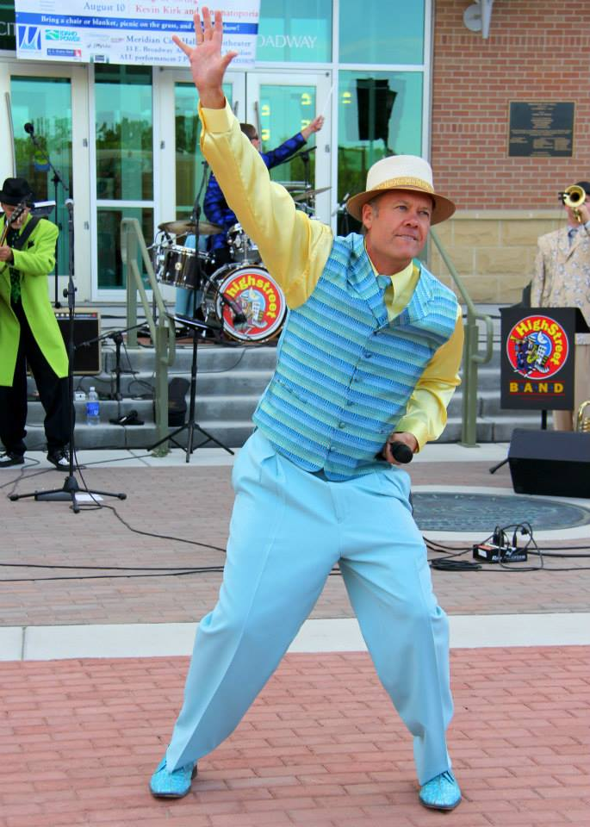
INITIATIVES
DOWNTOWN ACTIVITIES
Meridian City Hall continues to be a key gathering place for events such as the Fifth Annual Concerts on Broadway series featuring jazz, swing and symphony genres, the Public Works Expo, Meridian Business Days, the first annual Christmas Parade and the annual Christmas Tree lighting to name a few.
In October 2013, various downtown Meridian business and property owners came together to start discussions on a number of issues affecting downtown, including increasing the number of events in Meridian’s downtown beginning in 2014.
There is an exciting enthusiasm for the creation of more downtown activities. To this end, MDC committed additional funding for FY2014 to the Meridian Arts Commission in order to expand their Concerts on Broadway series from 3 to 4 events in the summer of 2014.

Slide 14
COMING IN 2014
2014 for MDC includes the following projects and initiatives for the Meridian Development Corporation:
Nine Mile Floodplain Study: A continuation of coordination with the City of Meridian’s Floodplain Administrator, Nampa-Meridian Irrigation District and the Corp of Engineers to determine potential opportunities to reduce the Nine Mile Floodplain impact for MDC property owners. It is anticipated that the federal government will release their draft study in mid-2014 for public comment. MDC will play a strong role in working to reduce the floodplain boundary.
Wayfinding and Signage Program: The adoption of a wayfinding and signage master plan and subsequent branding effort for signage design and the further implementation of the Destination: Downtown master plan is a key initiative for MDC in 2014.
Wine Cooperative: A determination of what is needed to accomplish a wine cooperative in downtown Meridian and how to collaborate and leverage partnerships with current downtown businesses.
Streetscape Program: The continuation to collaborate with the City of Meridian and downtown business and property owners on the priorities for downtown and to continue block by block transformations that include: street trees, historic lighting, construction or reconstruction of sidewalks and bike lanes where feasible. A key priority for MDC in 2014 is Main Street between Broadway and Pine.
Downtown Parking: To continue working with stakeholders to determine: on-going, short-term, and long-term goals for downtown parking. In 2014, it is MDC’s goal to create a strategic parking plan. Further, MDC will be investing in the creation of additional unrestricted parking along South Broadway Avenue.
Meridian Downtown Economic Development Partnership: The continuation of a formal collaboration between MDC, the city of Meridian and the Meridian Chamber of Commerce to address opportunities, initiatives and projects that are of interest to all. A summit between key leadership of all entities is expected in the first half of 2014.
Public Involvement: The foresight to continue to look towards collaborating with new and existing business owners to create continued opportunity in downtown Meridian.

Slide 15
IN CONCLUSION
Meridian Development Corporation is committed to public service, to the fiscally responsible use of urban renewal dollars and to public transparency. The following are links to MDC efforts of public and stakeholder interest:
MDC Website: www.meridiandevelopmentcorp.com
MDC Contact Information:
Ashley Ford, MDC Administrator
meridiandevelopmentcorp@gmail.com
208.477.1632
Mailing Address: 33 East Broadway Avenue, Meridian, Idaho 83642
Physical Address: 703 North Main Street, Meridian, Idaho 83642

Slide 16
APPENDIX A
FY2013 MDC Annual Audit

